Slide 1

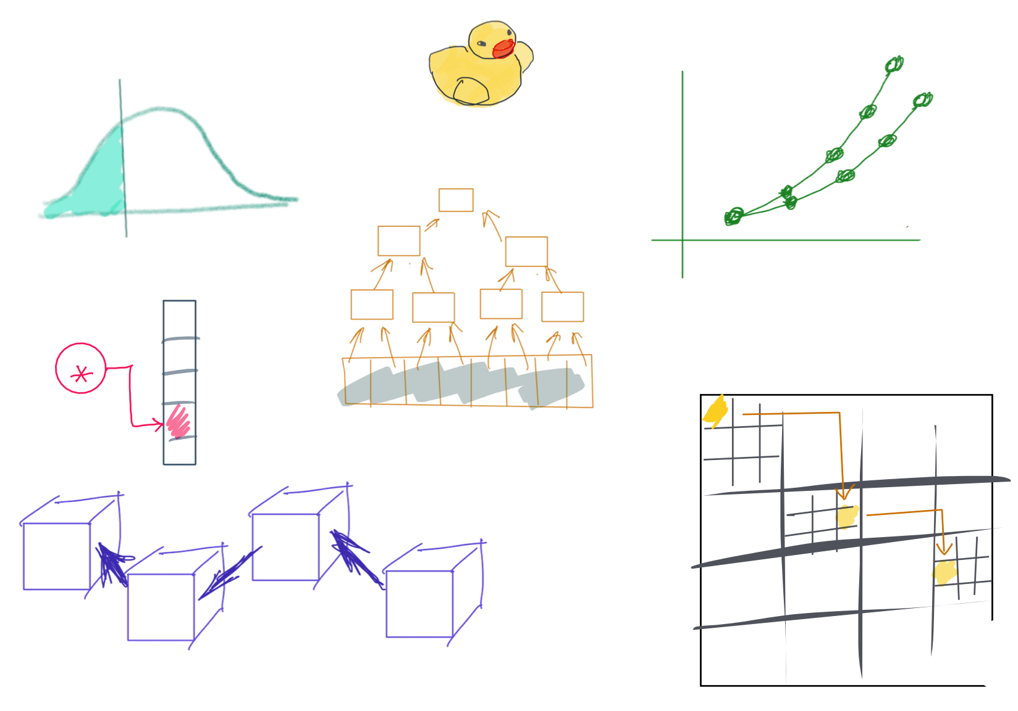

Slide 2
CSS342 Data Structures, Algorithms, and Discrete Mathematics (I)

Slide 3
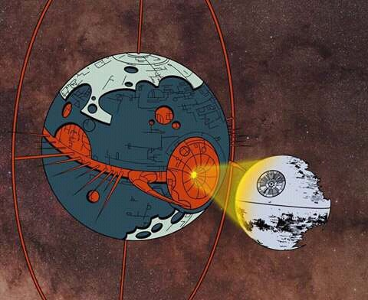
std::cout << “may the 4 b w y” << std::endl;

Slide 4
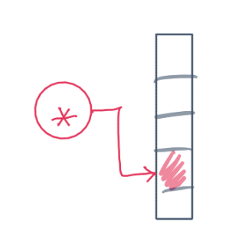
^{6th} Week Schedule
Homework 3 Review (Wed)
Midterm review (Wed)
Midterm (Friday, 5:45pm, 1.5-2 hrs, canvas submission)
No lecture after midterm on Friday
ADT hashtable (Wed)

Slide 5
Where are we at now?
ADT (array vs list)
One-dimensional ADT
ArrayList
Stack
LinkedList
Queue
Hash table
Recursion
Search Problem
Sorting
Binary tree
multi-dimensional ADT

Slide 6
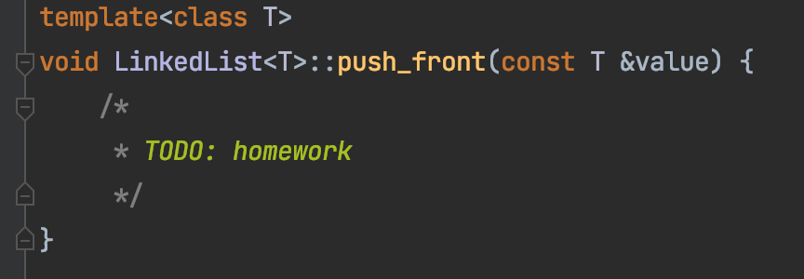
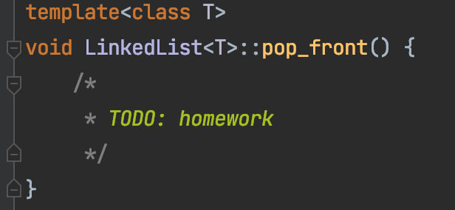
Homework 3 Review
h
2
1
3
4
n

Slide 7
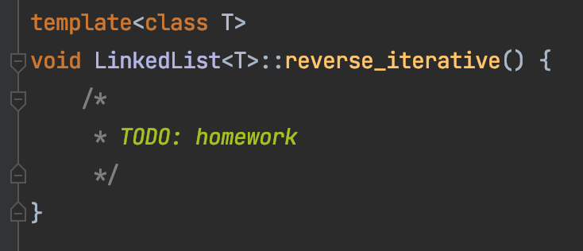
Homework 3 Review

Slide 8
An Idea
1-> 2
2-> 1
1-> 2-> 3
2->1->3
3->2->1
Starting from the head node
Iteratively swap each node to the front
3-> 4-> 1->9

Slide 9

Demo 3
h
1
2
3
4
n
2

Slide 10
Demo 3
h
2
1
3
4
n
3

Slide 11
Demo 3
h
3
2
1
4
n
4

Slide 12
Swap a node in a list to the front
h
2
1
3
4
n
head
p1
p2

Slide 13
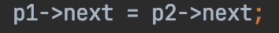
Swap a node in a list to the front
Step 1
h
2
1
3
4
n
head
p1
p2
Step 1

Slide 14

Swap a node in a list to the front
h
2
1
3
4
n
head
p1
p2
Step 2
Step 2

Slide 15
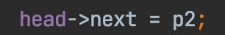
Swap a node in a list to the front
h
2
1
3
4
n
head
p1
p2
Step 3
Step 3

Slide 16

Swap a node in a list to the front
h
3
2
1
4
n
head
p2
p1
p2
Step 4
Step 4

Slide 17
Midterm Review
Use:
Slides
Code-along repo
Pointer & reference
Color math
Rubber duck
Cat & Dog
C++ Basics
Pointer, reference
Memory (“new”, “delete”)
Dangling pointer
C++ OOP
Based/derived class
Overload vs override
(pure) Virtual function
Abstract Data Type (ADT)
List (ArrayList, LinkedList)
Stack & Queue
Unit testing
Expect == Actual
Prevent accidental change of logic
By your future self, and
By others

Slide 18
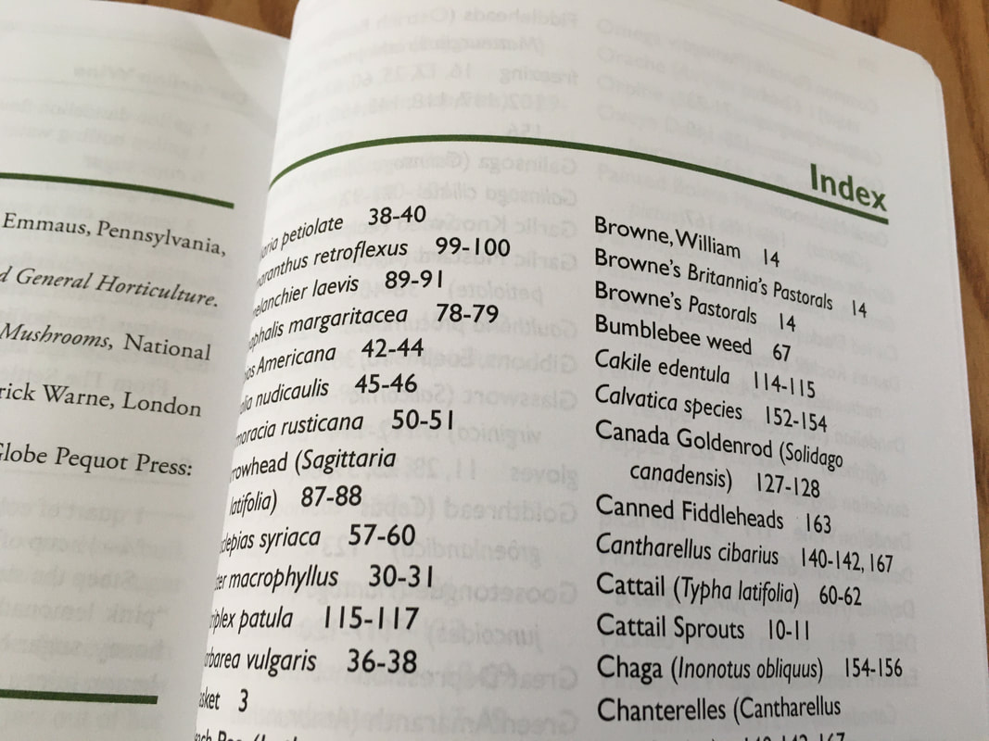
ADT HashTable
HashTable
Dictionary
Map
Set
O(1) “instant” search and insert/deletion

Slide 19
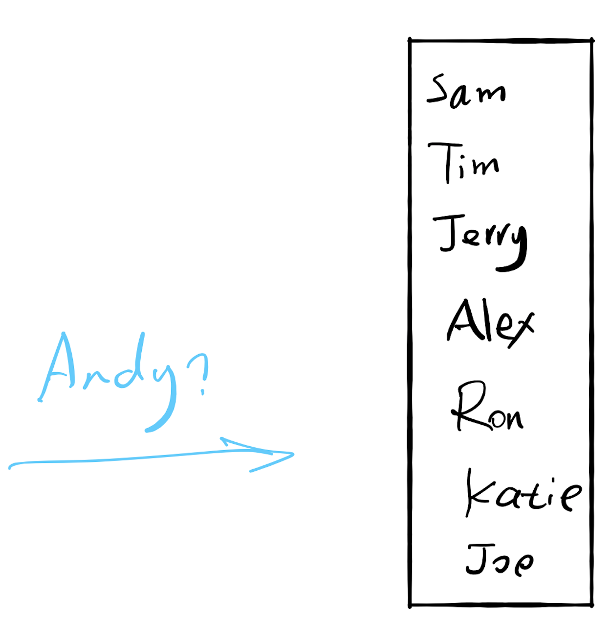

17.1 Search

Slide 20
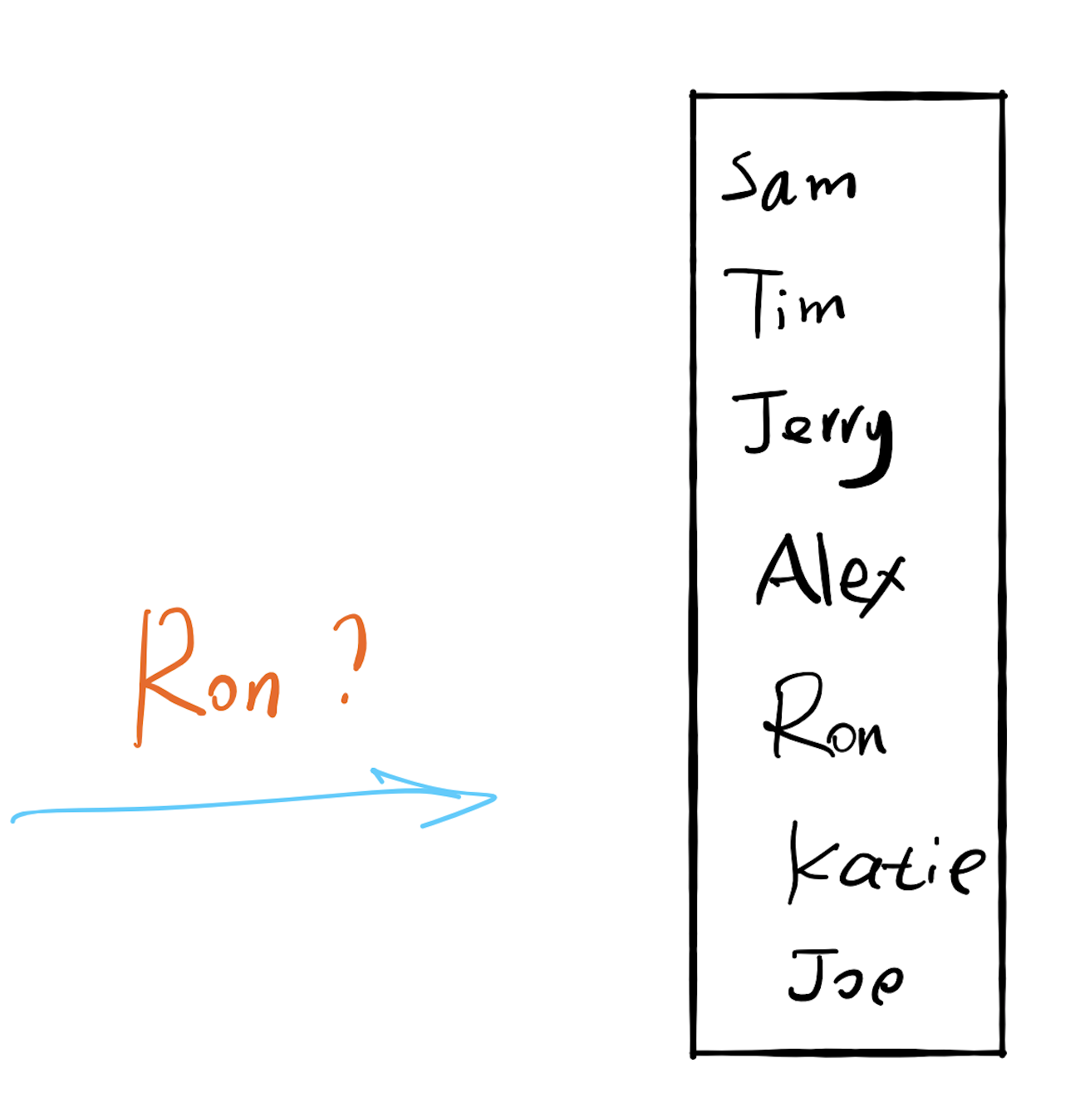

Slide 21
If there are 100 users
Each comparison takes 1 seconds
Worst case: 100 seconds (1.7 minutes)

Slide 22
If there are 10,000 users
Each comparison takes 1 seconds
Worst case: 10,000 seconds (2.8 hours)

Slide 23
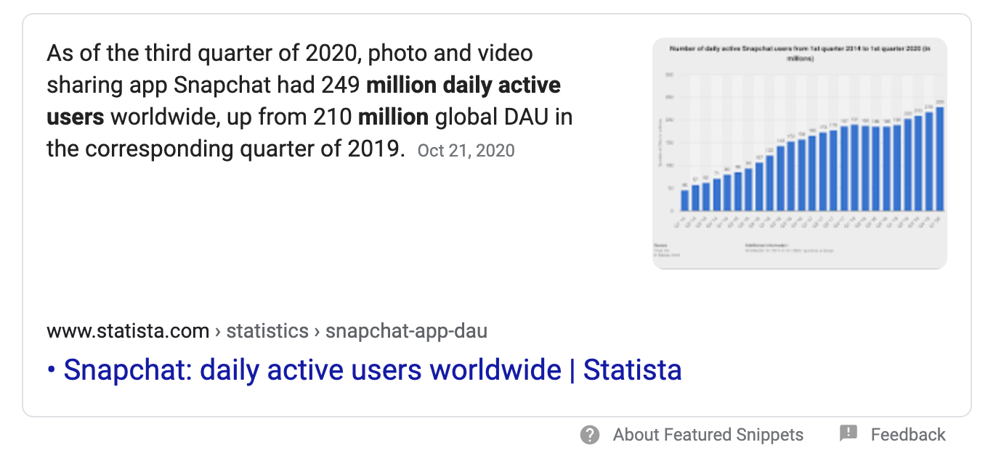
If there are 249 million users
Each comparison takes 1 seconds
Worst case: How long?

Slide 24
If there are 10,000 users
Worst case: 10,000 seconds (2.8 hours)
Can we do better?
Sort

Slide 25
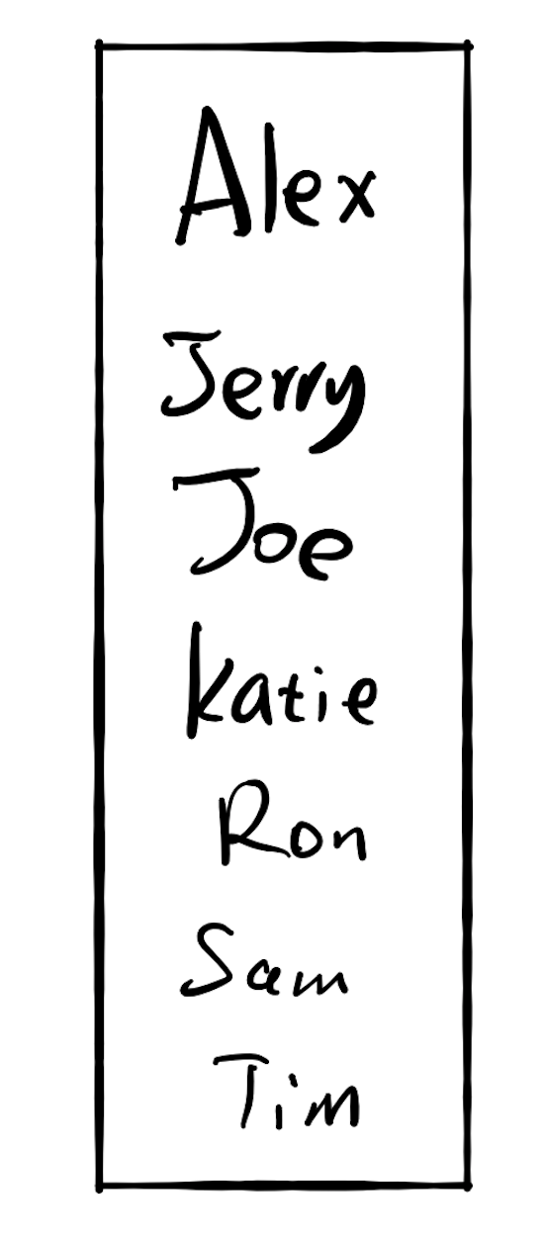
If there are 10,000 users
Worst case: 10,000 seconds (2.8 hours)
Worst case: 13.3 seconds

Slide 26
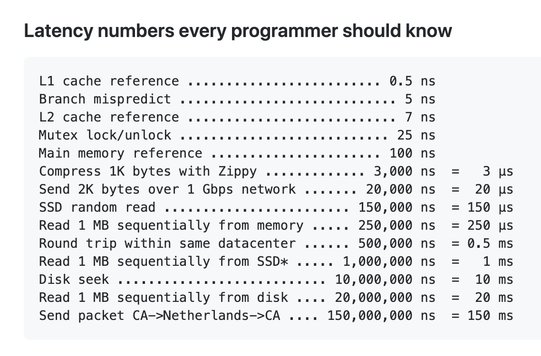
17.2 Insertion
If there are 10,000 users
Each memory ops takes 2 seconds
Because memory ops is slow
https://gist.github.com/hellerbarde/2843375

Slide 27
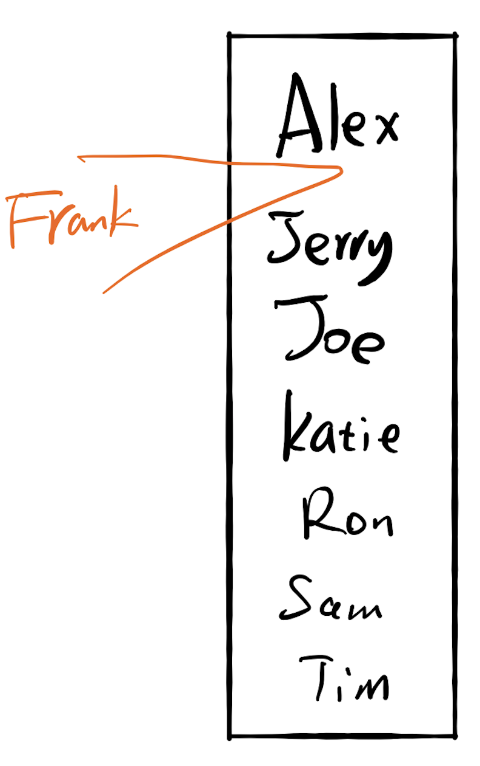
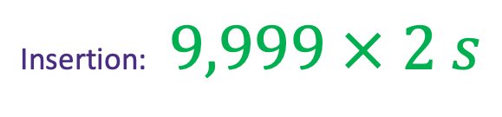
17.2 Insertion
If there are 10,000 users
Each memory ops takes 2 seconds
Search the location: 13.3 seconds
Insertion: $9,999 × 2 s$

Slide 28
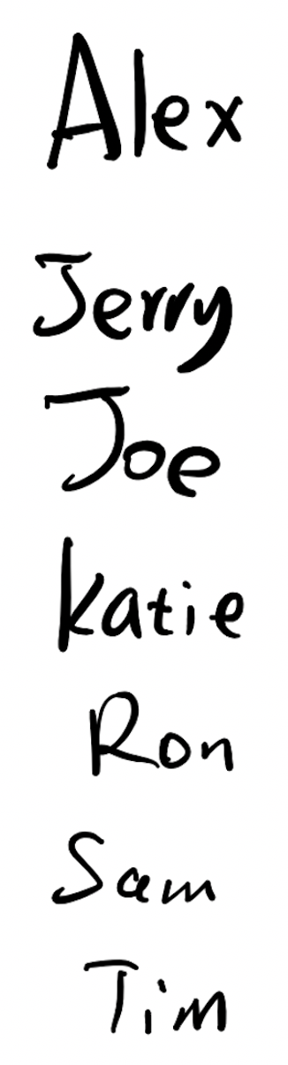

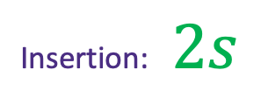
17.2 Insertion
If there are 10,000 users
Each comparison takes 1 seconds
Each memory ops takes 2 seconds
Insertion: $2s$
Search the location: ??

Slide 29
Fast for search
Slow for insertion
Slow for search
Fast for insertion

Slide 30
17.3 Do both fast?

Slide 31
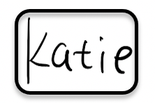
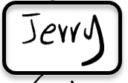
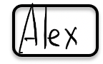
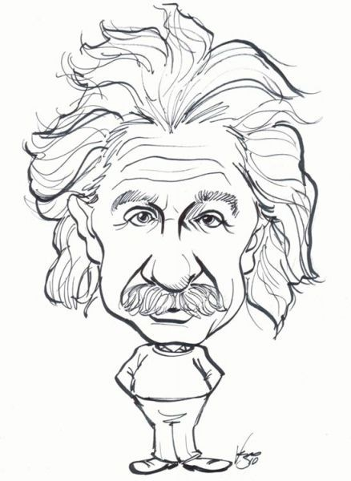

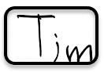



Slide 32
Hash Algorithm

Slide 33
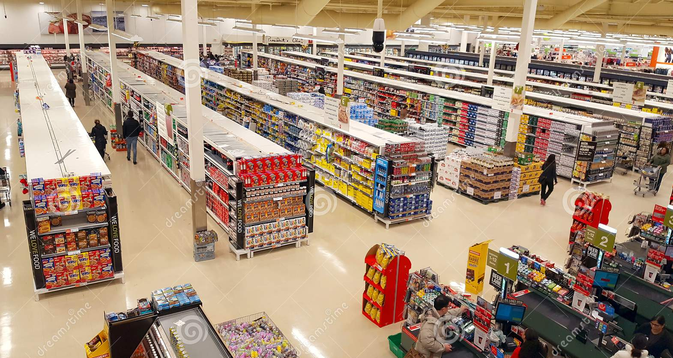
“Where is orange juice?”

Slide 34
0
3
6
7
9
12
13

Slide 35
0
3
6
7
9
12
13

Slide 36

0
3
hashing
6
7
9
12
13
hashing
8

Slide 37
6
value
keyword
“Key value pair”

Slide 38
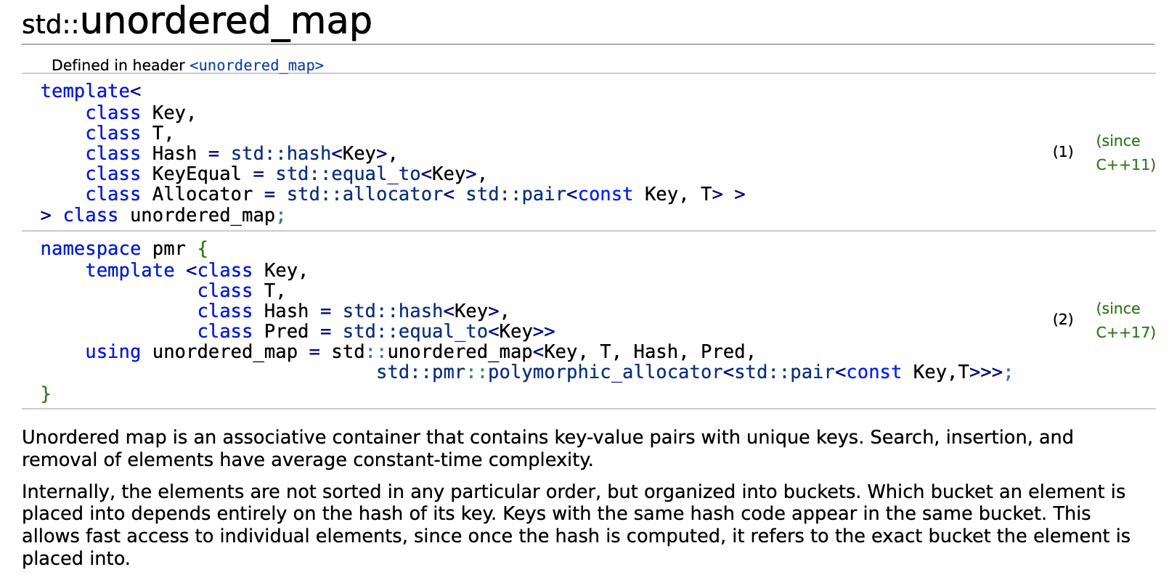
STD::unordered_map
“Internally, the elements are not sorted in any particular order, but organized into buckets. Which bucket an element is placed into depends entirely on the hash of its key. ”

Slide 39
Word Frequency
Give a text of words
You can't handle the truth! Son, we live in a world that has walls, and those walls have to be guarded by men with guns. Who's gonna do it? You? You, Lieutenant Weinberg? I have a greater responsibility than you can possibly fathom. You weep for Santiago and you curse the Marines. You have that luxury. You have the luxury of not knowing what I know, that Santiago's death, while tragic, probably saved lives. And my existence, while grotesque and incomprehensible to you, saves lives! You don't want the truth, because deep down in places you don't talk about at parties, you want me on that wall. You need me on that wall. We use words like "honor", "code", "loyalty". We use these words as the backbone of a life spent defending something. You use them as a punchline. I have neither the time nor the inclination to explain myself to a man who rises and sleeps under the blanket of the very freedom that I provide, and then questions the manner in which I provide it! I would rather you just said "thank you", and went on your way. Otherwise, I suggest you pick up a weapon, and stand a post. Either way, I don't give a damn what you think you are entitled to!
“A Few Good Men” https://www.youtube.com/watch?v=9FnO3igOkOk
Count how many times each word/sentence appears.

Slide 40
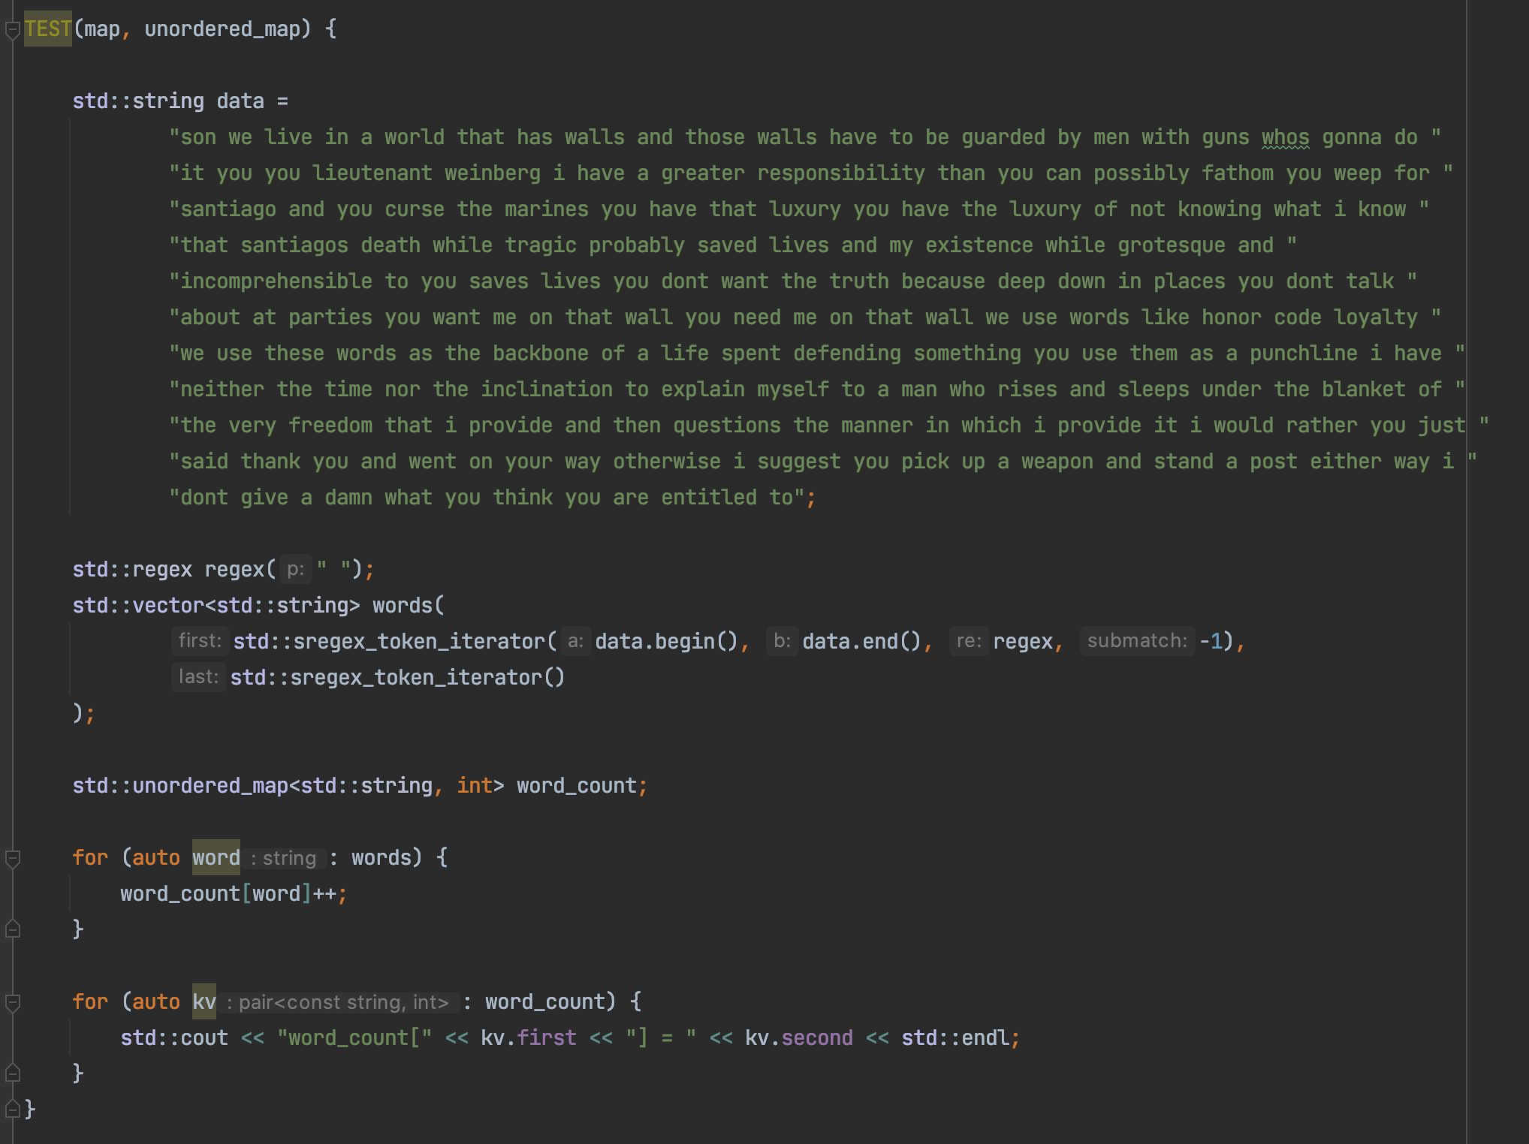
Word Frequency

Slide 41
HashTable Implementation

Slide 42
Hash Algorithm

Slide 43
0
3
hashing
6
7
9
12
13
hashing
8

Slide 44
Key value pair: (K, V)
(K,V)
Hash function
6
Hash key
key K

Slide 45
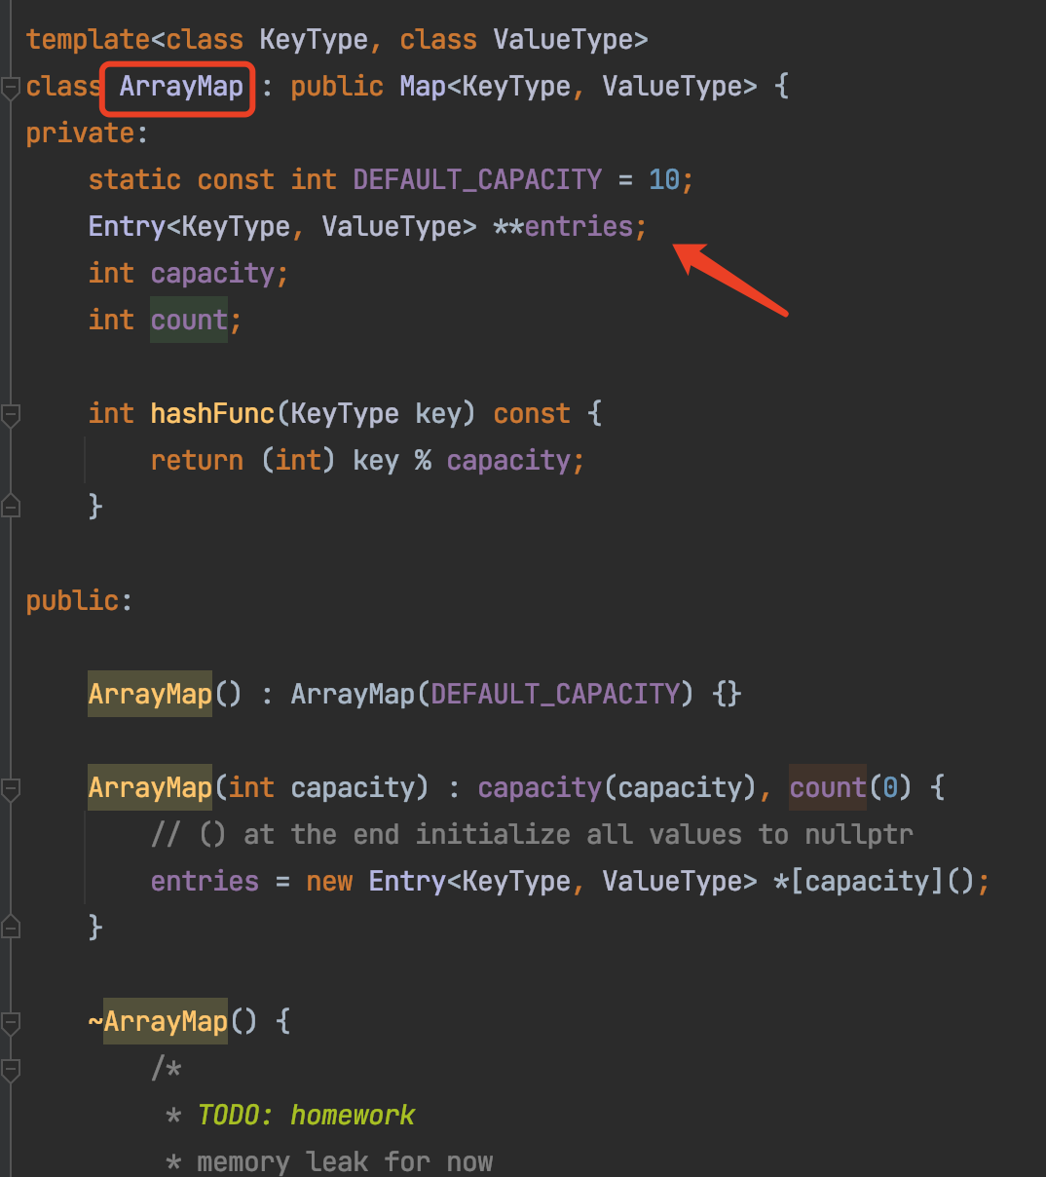
ArrayMap

Slide 46
Hashing
Key x
Index y
“Key”
“Hash Key”
String
Integer

Slide 47
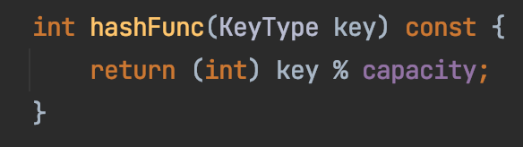
Hashing
Key x
Index y
String
Integer

Slide 48
Collision
collision
key=Sam
key=Ron

Slide 49
Collision
Three approaches
Better hashing algorithm
Find another location in the table
3. Modify the entry to be able to hold more than one set of values
https://medium.com/basecs/hashing-out-hash-functions-ea5dd8beb4dd
“open addressing”

Slide 50
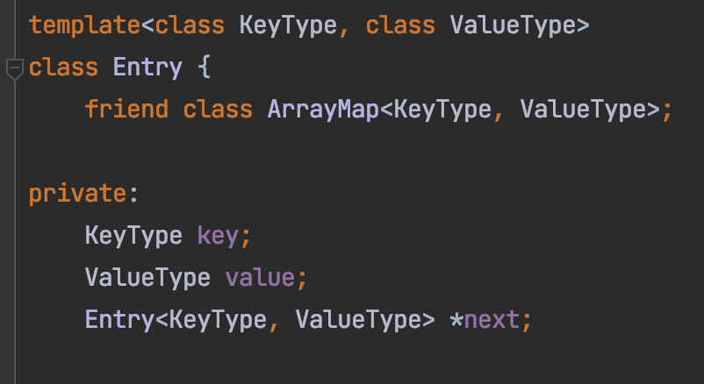
Chaining
Sam
Ron
key=Sam
key=Ron

Slide 51
Chaining
Sam
Ron
Alex
Jerry
Katie
Joe
Tim

Slide 52
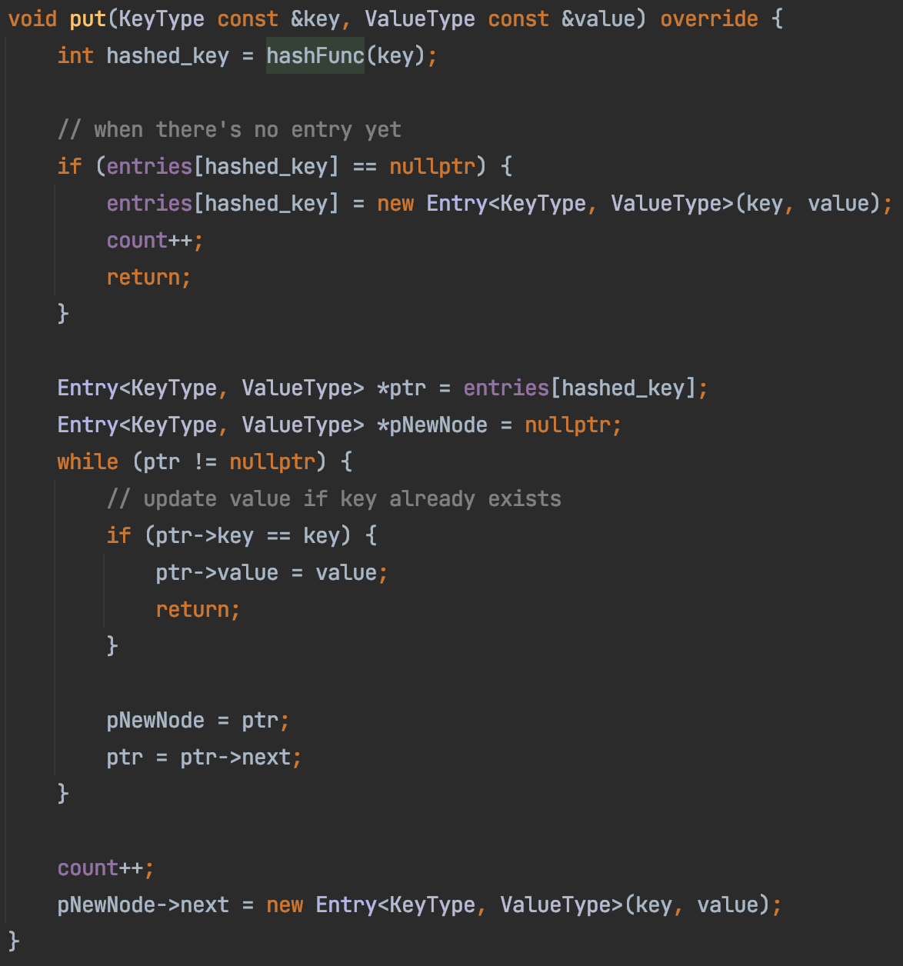
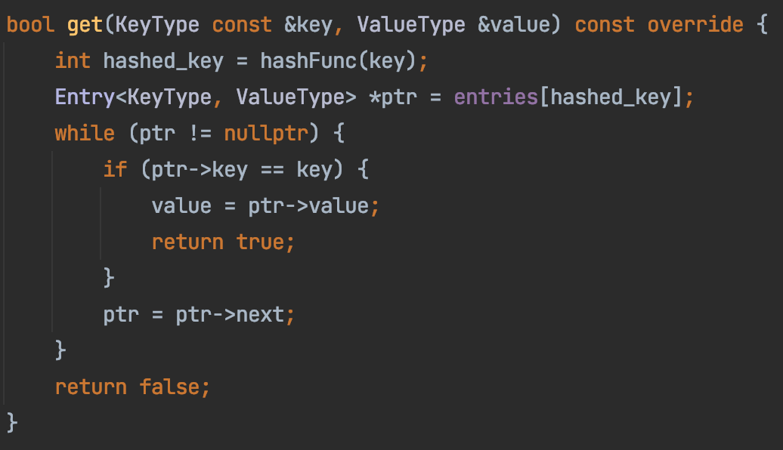
ArrayMap

